Slide 1

Customize the slides below with your own text, photos and logo.
Where you see “Insert your image/logo here,”
right click and choose Change Picture.

Slide 2

Welcome to

Slide 3



Tips to get you started:
Quick View
Click the icon in Windows Taskbar and choose View Slides.
On Desktops + Laptops
Browse slides via controls
at top right of screen.

Slide 4

Tips to get you started:
Clickable Slides
To exit the screen saver
from a clickable slide, click it or close
at the top right corner.
On Desktops + Laptops

Slide 5
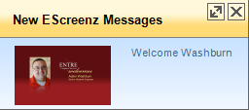




Tips to get you started:
New Message Notification
Appears at bottom right of screen when new messages are available.
On Desktops + Laptops
Expand
Close
New eScreenz Messages
Welcome Shawn Smith
VP of Purchasing
To see last notification, click
in Windows Taskbar and choose View Slides.

Slide 6



President Name
President
A Message from
the President
Type your message here such as a mission statement, thanks for extra effort on a project or announce an achievement.

Slide 7

President Name
President
A Message from the President
Type your message here such as a mission statement, thanks for extra effort on a project or announce an achievement.

Slide 8


welcome
Employee Name
Title
Department
Phone
Email

Slide 9

welcome
Employee Name
Title
Department
Phone
Email

Slide 10

Congratulations
"Teamwork is
the ability to work together toward a common vision. It is the fuel that allows common people to attain uncommon results."
Andrew Carnegie
Announce company achievement here.

Slide 11


Slide 12

Type here

Slide 13

January 2 (Monday)
New Year’s Day
May 28 (Monday)
Memorial Day
July 4 (Wednesday)
Independence Day
September 3 (Monday)
Labor Day
November 22 + 23 (Thursday + Friday)
Thanksgiving
December 24 + 25 (Monday + Tuesday)
Christmas
……………………………………..................................
January 1, 2013 (Tuesday)
New Year’s Day
enjoy the time off

Slide 14
Event Name
Mark your calendar
Date: XXXX
When: XXXXXXXXXX
Where: XXXXXXXXXXXXXX
Add more information about the event.

Slide 15

Join us!
IDEAS FOR THIS PAGE:
Announce an achievement
Link to article on the web
Announce a policy change
Event information

Slide 16

Have You Heard?
IDEAS FOR THIS PAGE:
Announce an achievement
Link to article on the web
Announce a policy change

Slide 17





Get Healthy. Stay Healthy.
Get tips and guidance to meet your wellness goals!
Click Here

Slide 18

HAPPY
make a wish
Birthday
Employee Name
Join us for cake in the activity room at 2:00 P.M!
Notes:
Happy font won’t remain the same

Slide 19

make a wish
HAPPY
Birthday
Employee Name
Join us for cake in the activity room at 2:00 P.M!

Slide 20

Today is John Smith’s birthday.
Happy Birthday, John!
Notes:
Shape with text won’t

Slide 21





One box or can CAN make a difference!
Please donate non-perishable foods for the food drive.
Now through
August 1st
Ideas:
Soup
Pasta
Rice
Cereal
Peanut Butter
Spices
Dressing

Slide 22
Use each slide below as is or customize as you wish.

Slide 23


Mom.
You will not find her in our kitchen.
Let’s keep it clean ☺
Please take a few
minutes to keep it tidy.

Slide 24

Know where
I am to EXIT in
an emergency!

Slide 25
Monday meetings set the tone for the week. Let’s make it one of assessment, goals and motivation.
Review agenda before attending
Begin 9:30 a.m.
Bring Activity Report
Share solutions
Memo:
Monday
Meetings

Slide 26

time sheet FRIDAY
REMEMBER
Time sheets are
due on Friday.

Slide 27


Help Conserve Energy
Please turn off your computer before you leave.

Slide 28
Strive for 5 cups a day
of your favorite fruits and vegetables

Slide 29

Taking
extra steps
can help
you reach
fitness
goals.

Slide 30

Reduce.
Reuse.
Recycle.

Slide 31

Save This Tree!
pick one
☞ Please think before you print.

Slide 32
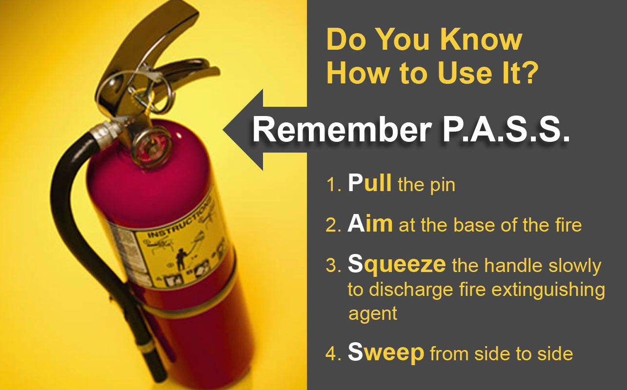

Slide 33

Disaster Preparedness
Once uploaded to Escreenz™, make slides below clickable to more information on an appropriate website or your Intranet.

Slide 34
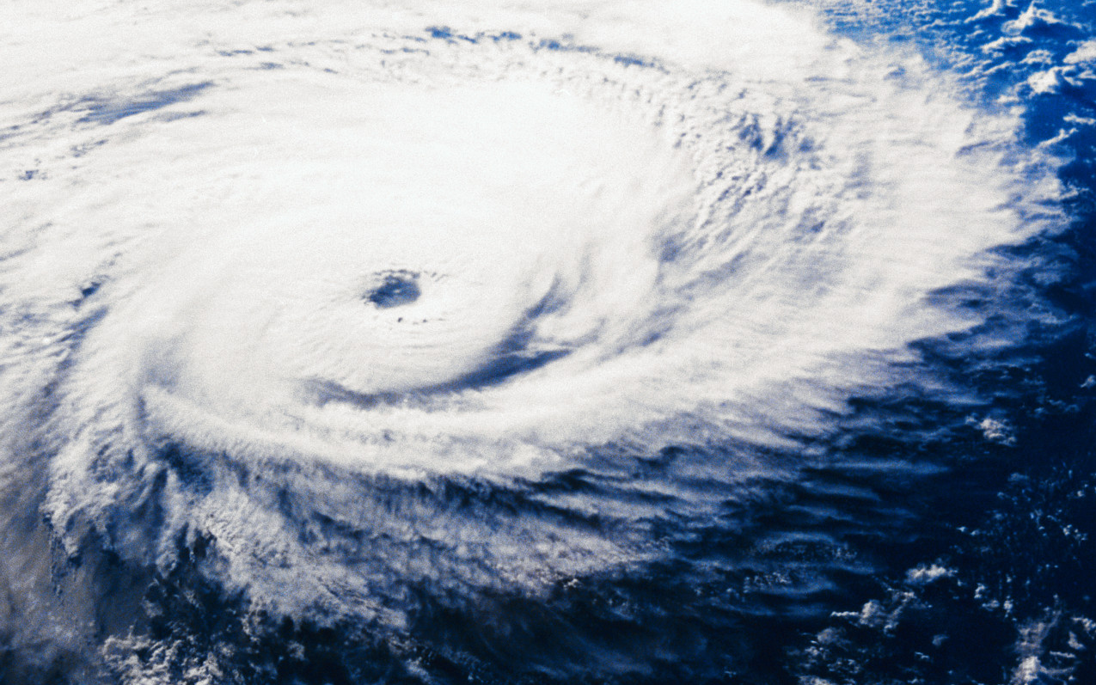
Hurricane Watch
Click for more information to
keep you and your family safe

Slide 35
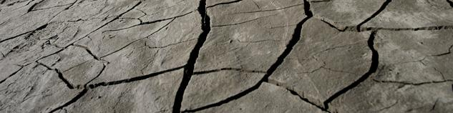

Earthquake Precautions
If you are indoors, get to a safe place where things will not fall on you, away from windows, bookcases and tall, heavy furniture.
Click
for more tips!

Slide 36


During a Flood
x
Do not try to drive over a flooded road.
The water can be much deeper than it appears, and you could be stranded or trapped.
Click
for more tips!

Slide 37
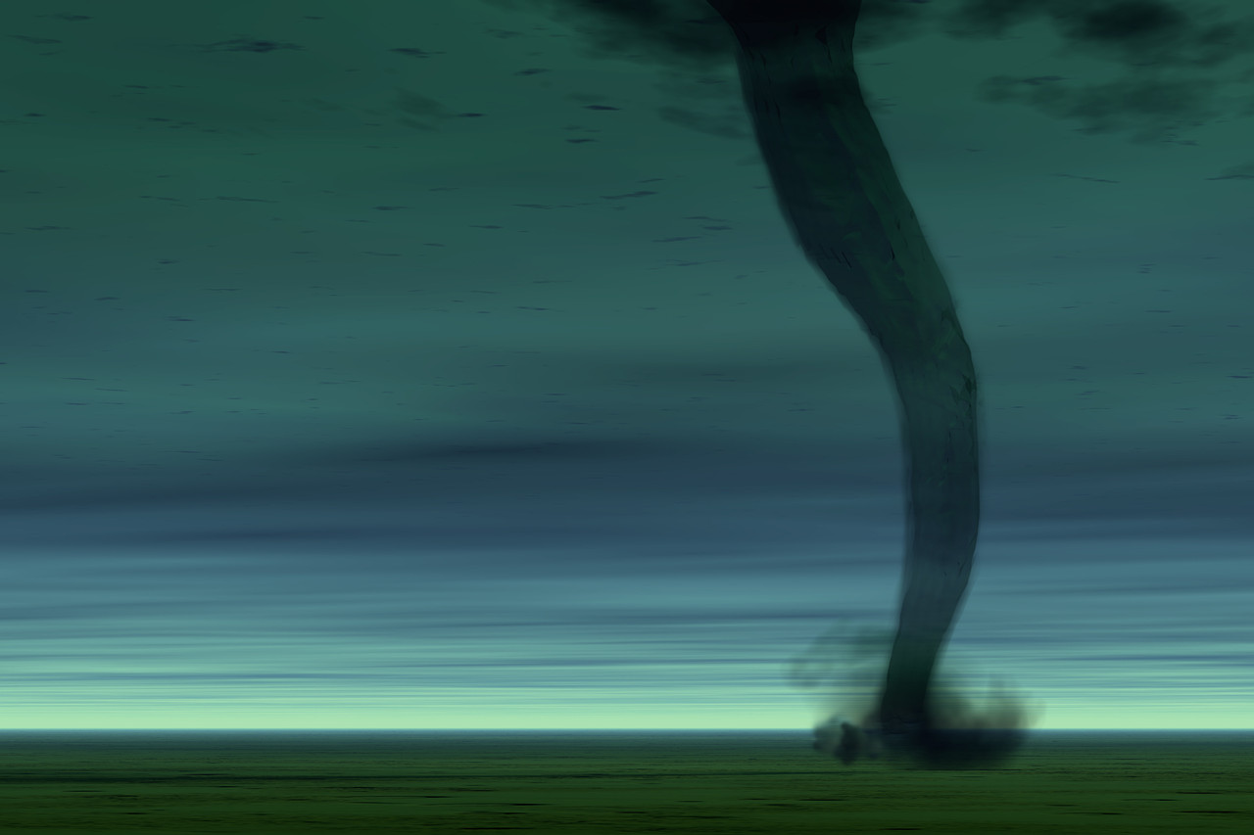
Tornado Watch
Click for more information

Slide 38
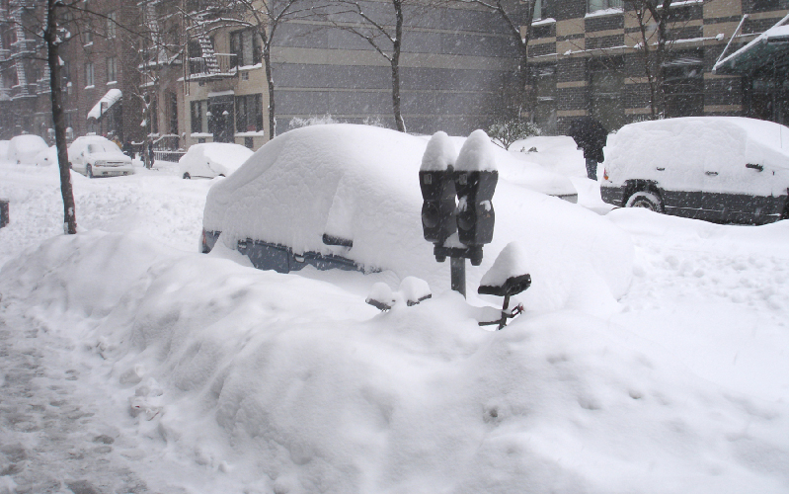
Storm Watch
Click for more information

Slide 39
Disaster Preparedness Lists
Add safety lists like the samples below
to your Intranet and then create clickable
slides to access them.

Slide 40
Hurricane Preparation
If you remain in your home during the storm, there are a number of steps you should take to stay as safe and comfortable as possible.
But you need to be aware that during hurricanes it is not the winds that cause the majority of death and destruction, but water/flooding from tidal surge. Once the tidal surge hits, there is no escape!
Obey mandatory evacuations.
Board up all windows to help prevent further damage to the interior of your home and injury from broken glass.
Secure all outdoor furniture to reduce the amount of damage to it, and to help prevent it from being thrown against your (or someone else's) home.
Turn off gas to prevent gas leaks from broken or damaged gas lines.
Stock up on battery powered flashlights, candles and have a battery powered radio.
Stock up on bottled water, as well as non-perishable foods that can be prepared and eaten without having to be cooked. Be sure to have enough food and water to last for everyone in the home for a week, including pets. And don't forget a can opener and a clean, sharp pocket knife.
If you have an infant on a bottle, have enough bottles on hand so that you won't have to worry about how you can wash them if there is no clean water. And be sure to either have single use sized cans of formula or an ice chest with plenty of ice to store any opened cans of formula.
Stock up on anti-bacterial hand wipes, gel hand cleaners and paper towels in the event there is no water for washing or bathing.
Have a two week supply of any prescription medications, as well as personal care items (tooth brushes and paste, hygiene products, etc.).
Have a well-stocked first aid kit in the event of injuries. Disinfectants, antiseptics, antibiotic creams, bandages, cotton balls, aspirin, Tylenol and a thermometer are some of the basics you need.
Make sure all vehicles have full gas tanks.
Have several changes of clothing for each member of the household, and if you have a baby still in diapers, have a two-week supply on hand.
Select the innermost part of your home, on the ground floor, to ride out the storm, but not a basement or cellar. In the event of flooding, being in those areas of your home may make it impossible to escape. Stay away from all windows and glass doors!
Have mattresses, blankets, pillows, etc. already in place before the storm hits.
It would also be a good idea to purchase a bedside commode in the event the water and plumbing is rendered out of order during the storm. You can line the receptacle bucket with small garbage bags to make clean-up much easier and more sanitary. These can be purchased from any medical supply store, as well as many drug stores.
Have a supply of books, puzzles, toys, etc. in the event the electricity is off, especially if you have children.
You may want to purchase a portable generator. This is especially important if someone in the household is on oxygen or other electrical powered medical equipment; it will also keep the foods in your refrigerator/freezer from spoiling in the event of an electrical outage. But if you do use a generator, be sure to follow all instructions and safety precautions that come with it, and do not operate it indoors (carbon monoxide!).
Fill all bath tubs with clean water; it can be used for sponge baths, flushing toilets, etc. But if there are young children or pets in the home, be sure the door is kept securely closed at all times to prevent a child or pet from falling in the tub and drowning. A young child can drown in two inches of water!
Go over emergency instructions with everyone in the household such as everyone staying together, away from all windows, etc.
Also, if there are several members in the household, develop an "accounting system", where everyone is accounted for at all times in the event the storm gets really intense.
Since water/flooding caused by tidal surge is the leading cause of death and destruction in hurricanes, it is crucial to be aware of your surroundings. If you observe water coming into your house, get to an upper floor immediately.
If you have pets that stay outside, bring them in during the storm.
Have enough cash on hand to last for a while in the event you can't get to the bank or an ATM.
Put all important papers and documents (birth certificates, drivers licenses, insurance information, etc.) in a waterproof zip lock bag and keep it with you or at least a copy of these. Leave a bit of air in the bag before closing; in the event of flooding it will help it to float, making it easier to find. If you have a safe that you keep these in, you still need to put them in a zip lock bag to help keep them dry.
Do not wait until the last day to purchase supplies (food, water, etc.) or you run the risk of there being very little - or even none - of the supplies left that you need. It's a good idea to stock up on all non-perishables at the beginning of hurricane season.
Have a cell phone, fully charged, with you so you will have a way to call emergency services if needed and to contact family/friends to let them know if you are all ok. Just keep in mind that the cell towers may not be working for a while, so it would be a good idea to have a back-up plan to notify family/friends.
This is only a sample preparedness list. Use information appropriate to your area.

Slide 41

If you are outside: stay outside.
If you are inside: drop, cover, and hold on.
Get under a desk, table or bench. Hold on to one of the legs and cover your eyes. If there's no table or desk nearby, sit down against an interior wall. An interior wall is less likely to collapse than a wall on the outside shell of the building.
Pick a safe place where things will not fall on you, away from windows, bookcases, or tall, heavy furniture.
It is dangerous to run outside when an earthquake happens because bricks, roofing, and other materials may fall from buildings during and immediately following earthquakes, injuring persons near the building.
Wait in your safe place until the shaking stops, then check to see if you are hurt.
You will be better able to help others if you take care of yourself first, then check the people around you.
Move carefully and watch out for things that have fallen or broken, creating hazards. Be ready for aftershocks.
Be on the lookout for fires. Fire is the most common earthquake related hazard, due to broken gas lines, damaged electrical lines or appliances, and previously contained fires or sparks being released.
If you must leave a building after the shaking stops, use the stairs, not the elevator. Earthquakes can cause fire alarms and fire sprinklers to go off. You will not be certain whether there is a real threat of fire. As a precaution, use the stairs.
If you are outside in an earthquake, stay outside. Move away from buildings, trees, streetlights and power lines. Crouch down and cover your head. Many injuries occur within 10 feet of the entrance to buildings. Bricks, roofing, and other materials can fall from buildings, injuring persons nearby. Trees, streetlights, and power lines may also fall, causing damage or injury.
Assemble a Disaster Supplies Kit
Earthquake-specific supplies should include the following: A flashlight and sturdy shoes by each person's bedside; Disaster Supplies Kit; and an Evacuation Supply Kit.
This is only a sample preparedness list. Use information appropriate to your area.
Earthquake Precautions

Slide 42
During A Flood
Avoid areas subject to sudden flooding.
Do not attempt to cross a stream where water is above your knees. When in doubt, don't try it.
Do not try to drive over a flooded road. The water can be much deeper than it appears and you could be stranded or trapped.
Do not try to drive around police barricades.
Stay away from drains and ditches.
After a Flood
Do not eat fresh food that has come in contact with flood waters.
Boil drinking water before using.
Report broken gas, electrical and water lines immediately.
Do not handle electrical equipment in wet areas.
Do not sightsee. Your presence could impede relief efforts as well as endanger yourself.
Cooperate with local officials. Respond to requests for assistance from local police, firefighters and relief workers. Community participation is critical to effective disaster relief.
Flood Safety
This is only a sample preparedness list. Use information appropriate to your area.

Slide 43
Tornado Safety
Go to the basement or center of an interior room
  Stay away from corners, windows, doors, outside walls
  Put as many walls as possible between you and the outside
  Do not open windows
This is only a sample preparedness list. Use information appropriate to your area.

Slide 44

Dress in several layers of lightweight clothing, wear mittens and a hat (preferably one that covers your ears).
Wear waterproof, insulated boots to keep your feet warm and dry and to maintain your footing in ice and snow.
Minimize travel. If travel is necessary, keep a disaster supplies kit in your vehicle.
Listen to a NOAA Weather Radio or other local news channels for critical information from the National Weather Service (NWS).
Keep your vehicle’s gas tank full. A full tank will keep the fuel line from freezing.
Insulate your home by installing storm windows or covering windows with plastic from the inside to keep cold air out.
Maintain heating equipment and chimneys by having them cleaned and inspected every year.
Bring pets/companion animals inside during winter weather. Move other animals or livestock to sheltered areas with non-frozen drinking water.
Running water, even at a trickle, helps prevent pipes from freezing.
All fuel-burning equipment should be vented to the outside and kept clear.
Blizzard Safety
This is only a sample preparedness list. Use information appropriate to your area.

Slide 45
Ready? Send Slides to eScreenz™
1. Click Save As and choose JPEG
(JPEG is a choice under the Save as Type drop down)
2. When asked, “Do you want to export every slide or just the
current slide?” choose Every Slide* to include them all
3. Right click on the folder, choose Send to
and Compressed (zipped) Folder
Log in to EScreenz™ and upload the zip file
*Instruction slides like this one will also be included if you choose Every Slide. Once you upload the zip file to EScreenz™, you can Archive these and any slide you’re not ready to use.

